Slide 1
Acids, Bases and Buffers
Chapter 2 pg. 28-29

Slide 2
Characteristics of Acids
Acids are solutions with a greater number of hydrogen ions (H⁺) than hydroxide (OH⁻)
Acids taste sour.
Acids turn blue litmus paper red.
Acids have a pH below 7.
Examples of acids include stomach acid, lemon juice, cola, vinegar, coffee and rain water.

Slide 3
Characteristics of Bases
Bases have a greater concentration of hydroxide ions than hydrogen ions.
Bases taste bitter.
Bases feel slippery.
Bases turn red litmus paper blue.
Bases have a pH greater than 7.

Slide 4
The pH Scale.
The pH scale measures how acidic or basic a solution is.
The pH scale ranges from 0-14. A pH less than 7 is an acidic solutions and a pH greater than 7 are basic.
pH means “per hydrogen ions”.
pH=7 is neutral = 1 x 10⁻⁷ hydrogen ion concentration.
H₂O [H⁺] + [OH⁻]
Neutralization reactions: when an acid is added to base the product is a salt and water.
HCl + NaOH NaCl + H₂O

Slide 5
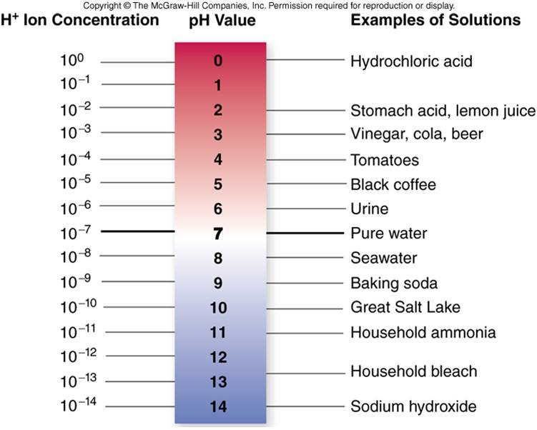
The pH Scale
Start Your Own Site
Letsgetsmarter on WordPress.com
There's more to discover in the WordPress app.

Slide 6
Buffers
A buffer is a chemical or combination of chemicals that keep the pH in a “normal” range.
Buffers resist pH changes by absorbing excess acids (H⁺ ions) or bases (OH⁻ ions).
Buffers in the stomach maintain the pH between 2.5 and 3.0.
Buffers in the blood maintain the pH at 7.4 because of carbonic acid (H₂CO₃) and bicarbonate ions (HCO₃⁻).
H₂CO₃ H⁺ + HCO₃⁻

Slide 7
Buffers in Biology
Health of organisms requires maintaining pH of body fluids within narrow limits
Human blood normally 7.4 (slightly basic)
Many foods and metabolic processes add or subtract H⁺ or OH⁻ ions
Reducing blood pH to 7.0 results in acidosis
Increasing blood pH to 7.8 results in alkalosis
Both life threatening situations!

